Slide 1


Board of Port Commissioners
FEBRUARY 18, 2026

Slide 2
ADMIN
AGENDA
Call to Order
Pledge of Allegiance
Roll Call

Slide 3
ADMIN AGENDA
Adoption of the
February 18, 2026 Agenda
Approval of Minutes
February 4, 2026
Regular Meetings

Slide 4
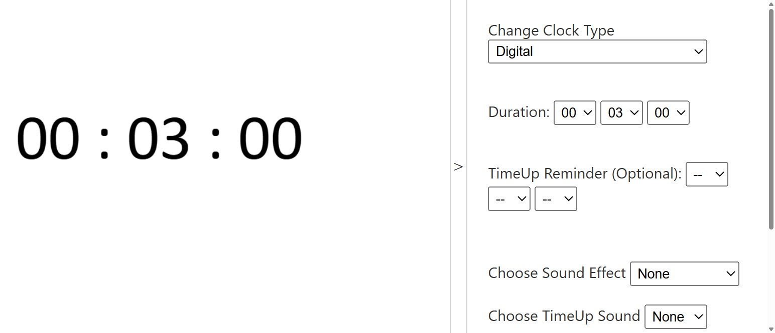
Public Communication
ADMIN agenda
ITEMS NOT ON THE AGENDA

Slide 5
ADMIN
AGENDA
Closed Session Report
Board Communications
Staff and General Manager Reports

Slide 6
CONSENT AGENDA ITEMS
Approval of Out-of-Town Travel Request(s)
B) Approval of Payments for January 2026
C) Approval of Office Lease Amendment No. 9 for GSA National Park Service
1431 Spinnaker Drive and 1691 Spinnaker Drive #204, 206, 208, 101B and 103

Slide 7
Public Communication
CONSENT agenda

Slide 8
CONSENT AGENDA ITEMS
Approval of Out-of-Town Travel Request(s)
B) Approval of Payments for January 2026
C) Approval of Office Lease Amendment No. 9 for GSA National Park Service
1431 Spinnaker Drive and 1691 Spinnaker Drive #204, 206, 208, 101B and 103

Slide 9
Standard AGENDA Item
1
Adoption of Resolution No. 3549 Approving the Financial Statements for October through December 2025
RECOMMENDATION:
That the Board of Port Commissioners adopts Resolution No. 3549 accepting the financial statements for the Quarter ending December 2025.
Report by:
Sarah Clancy
Administrative Services Manager

Slide 10
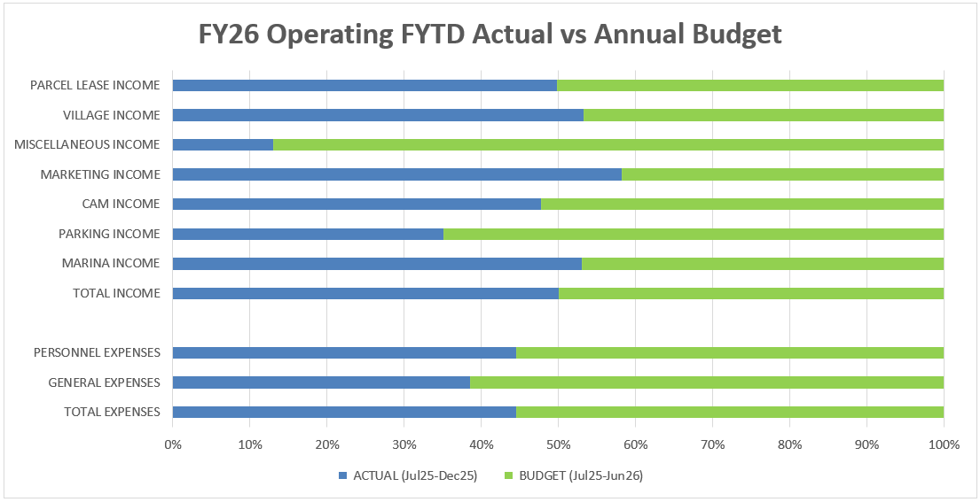
ytd actual vs annual budget

Slide 11
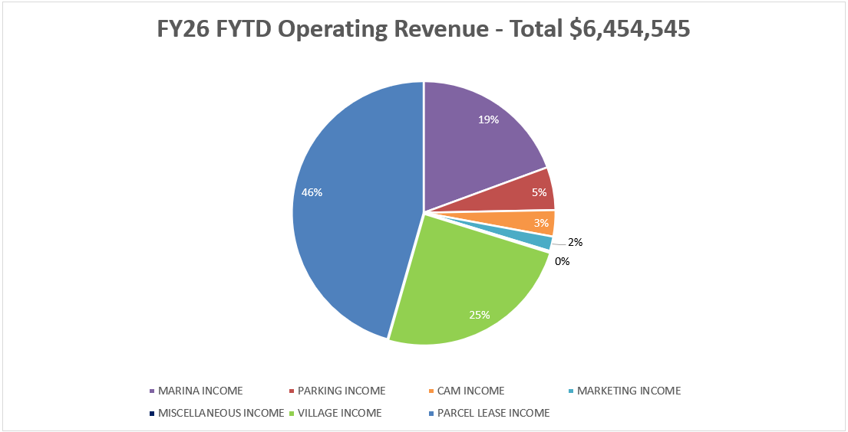
YTD Revenues

Slide 12
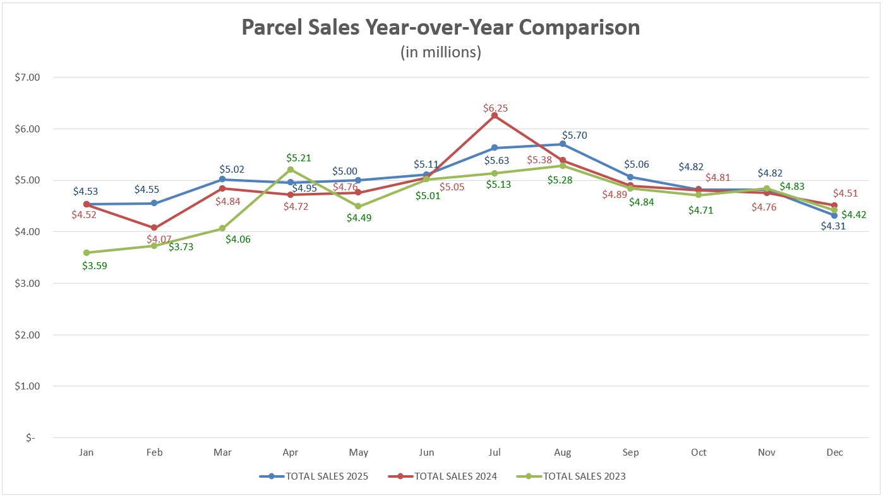
PARCEL Sales History

Slide 13
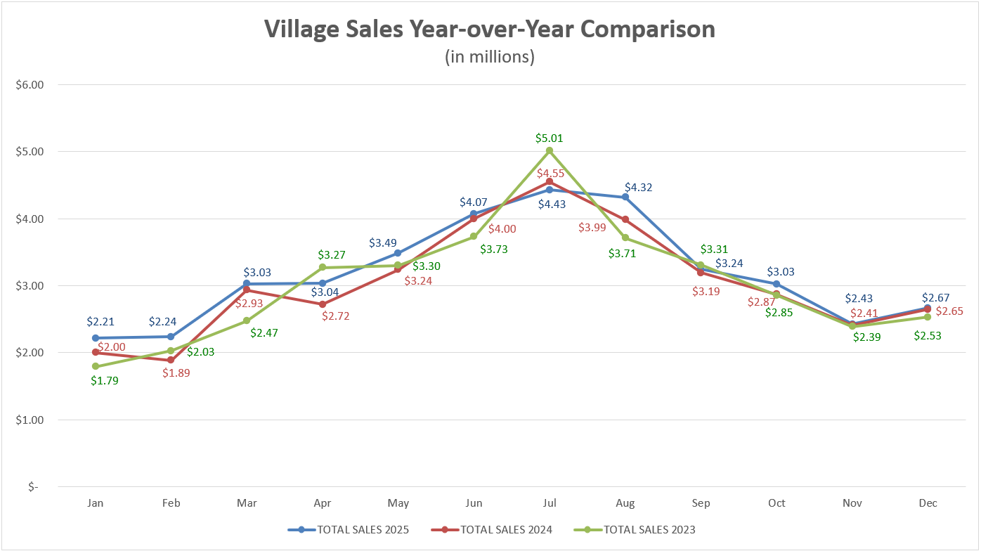
Village Sales History

Slide 14
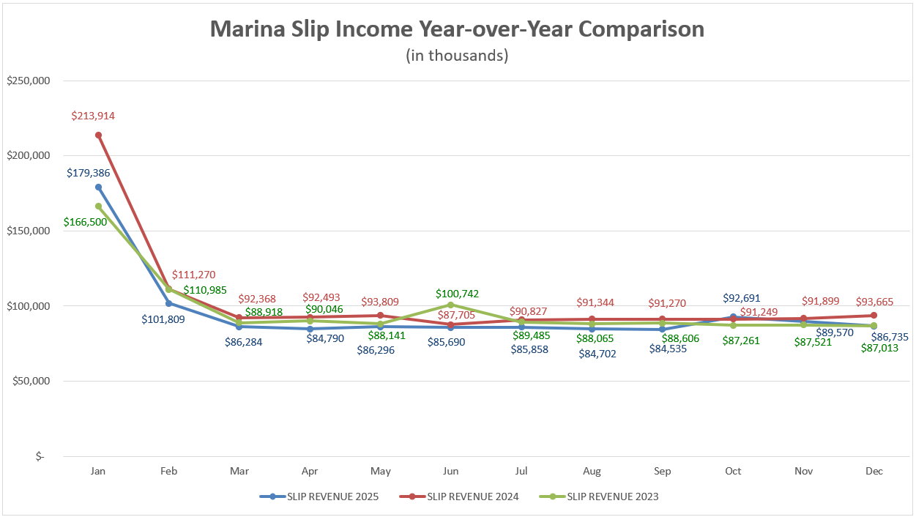
Marine slip income history

Slide 15
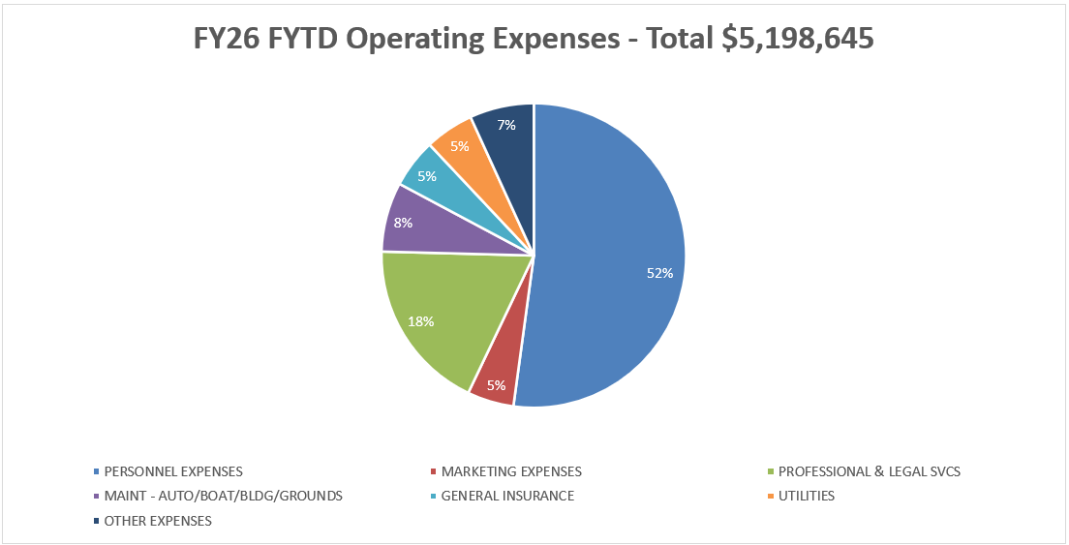
YTD Expenditures

Slide 16
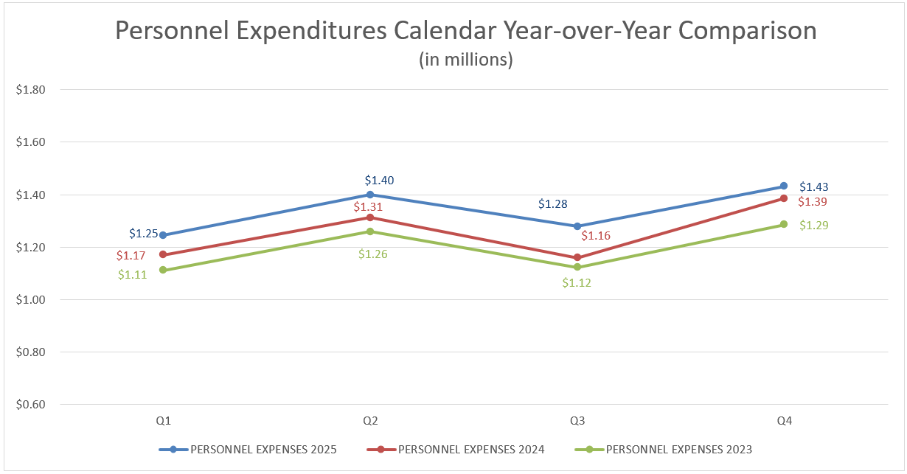
PERSONNEL EXPENSE HISTORY

Slide 17
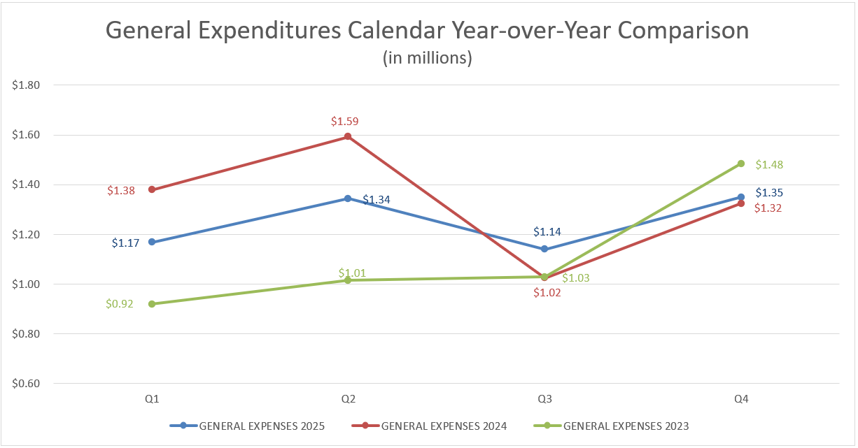
GENERAL Operating EXPENSE HISTORY

Slide 18
Non operating revenues & Expenses
  NON OPERATING REVENUES
    Interest Income – Recorded Monthly/Quarterly
      Rates are decreasing
    Tax and Assessment Income – Receive cyclically
      45% received in December
      45% received in May
      10% received in June
    Other Non Operating Income – Received sporadically
      Grant Income – Expecting $770k from grant reimbursements
      FEMA Income – Expecting $1.1M from 2023 January Storm Event
  NON OPERATING EXPENDITURES
    Depreciation Expense – Recorded Monthly/Quarterly
    Interest Expense– Paid cyclically in bi-annual debt payments
      July & January

Slide 19
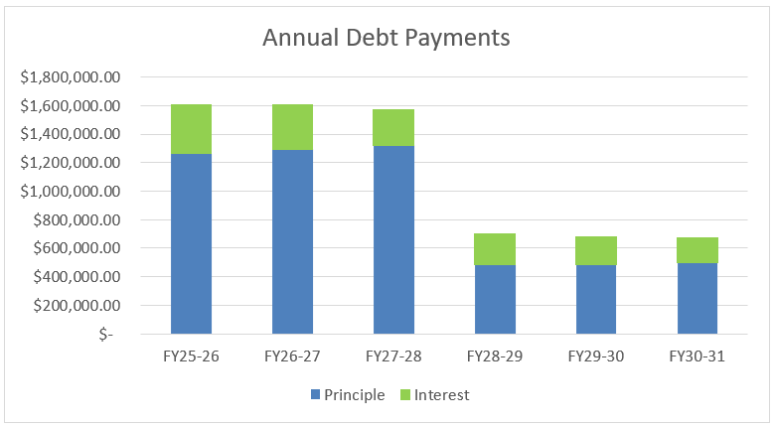
Current Debt OUTLOOK

Slide 20
Public Communication
STANDARD ITEM 1

Slide 21
Standard AGENDA Item
1
Adoption of Resolution No. 3549 Approving the Financial Statements for October through December 2025
RECOMMENDATION:
That the Board of Port Commissioners adopts Resolution No. 3549 accepting the financial statements for the Quarter ending December 2025.
Report by:
Sarah Clancy
Administrative Services Manager

Slide 22
Standard AGENDA Item
2
Adoption of Resolution No. 3550 Approving the Fiscal Year 2025-2026 Mid-Year Budget Adjustments and Capital Improvement Plan, Resolution No. 3551 Establishing the Salary Schedule for Non-Represented Employees of the District Effective January 1, 2026 and Rescind Resolution No. 3534
RECOMMENDATION:
That the Board of Port Commissioners:
a) Adopt Resolution No. 3550 approving the Mid-Year Budget Adjustments for Fiscal Year 2025-2026 effective January 1, 2026.
b) Adopt Resolution No. 3551 establishing the Salary Schedule for Non-Represented Employees of the District effective January 1, 2026.
c) Rescind Resolution No. 3534.
Report by:
Brian D. Pendleton, General Manager
Sarah Clancy, Administrative Services Manager
Justin Fleming, Capital Projects Manager

Slide 23
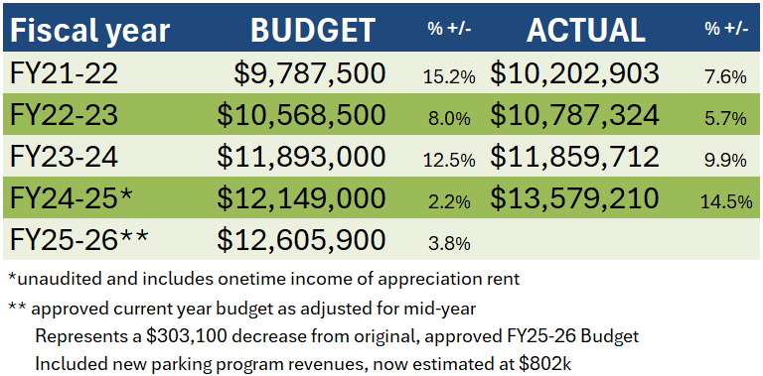
Operating Revenues

Slide 24
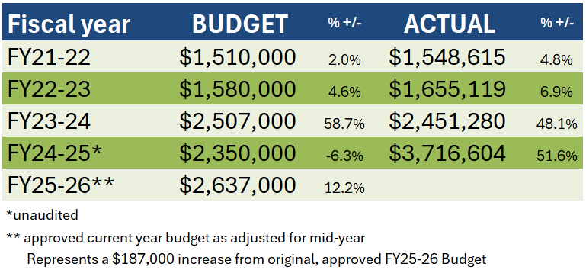
Nonoperating income

Slide 25
Grants & special funding Recommendations
Funds Received in FY 25-26
  CALeVIP
    $59,000 – Added to Mid-Year Budget
  Insurance Claims for VHV 1559 Spinnaker Dr Flood Damage
    $425,000 – Adjustment from Annual Budget of $6oo,000
  FEMA/CDAA - 2023 January Storm Event
    Building, Dock, And Equipment Grant
      $9,000 – Added to Mid-Year Budget

Slide 26
Grants & special funding recommendations Cont’d
Anticipated Funds
  National Fish & Wildlife Fund
    $200,000 – Adjustment from Annual Budget of $40,000
  Division of Boating & Waterways
    SAVE Grant
      $40,000 – Added to Mid-Year Budget

Slide 27
Grants & special funding Continued
  Awarded/Obligated Grants
    Division of Boating & Waterways
      Public Launch Ramp
        $544,847 – Not included in FY25-26; Anticipated FY 25-26 or FY 26-27
    FEMA/CDAA - 2023 January Storm Event
      Inner-harbor Dredge Grant
        $1,410,615 – Not included in FY25-26; Anticipated FY 25-26 or FY 26-27
  Future Grant Awardee Announcements
    Land and Water Conservation Fund – Parcel 5 Park Project Grant
    Port Infrastructure Development Program – Fish Pier Grant

Slide 28
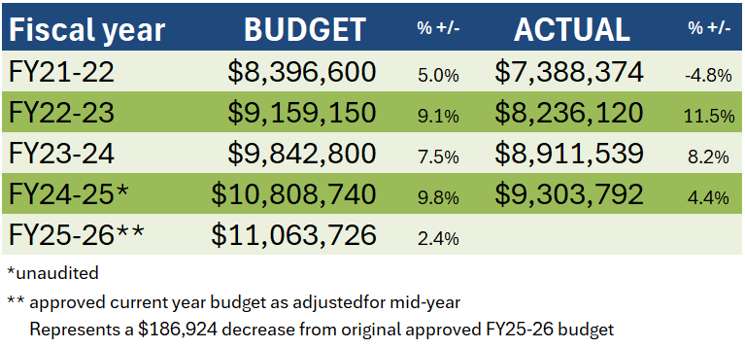
Operating EXPENSES

Slide 29
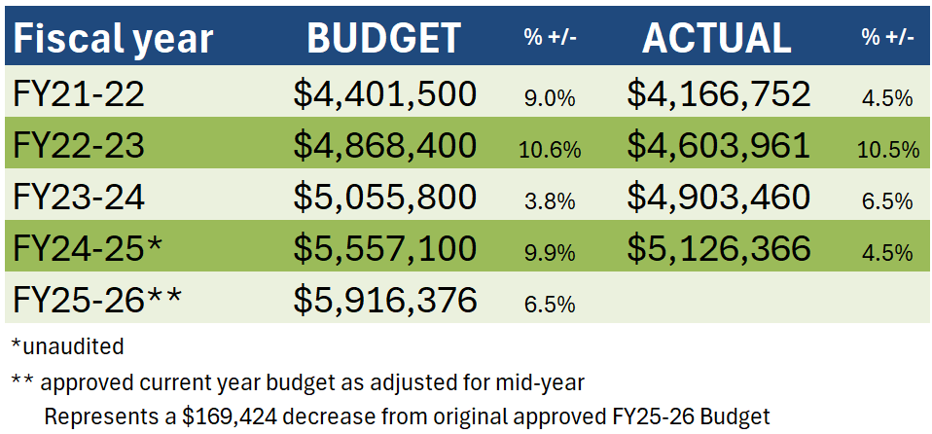
PERSONNEL EXPENSES

Slide 30
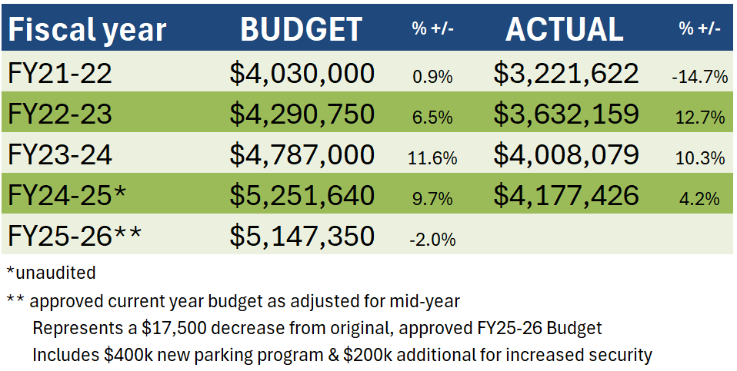
GENERAL EXPENSES

Slide 31
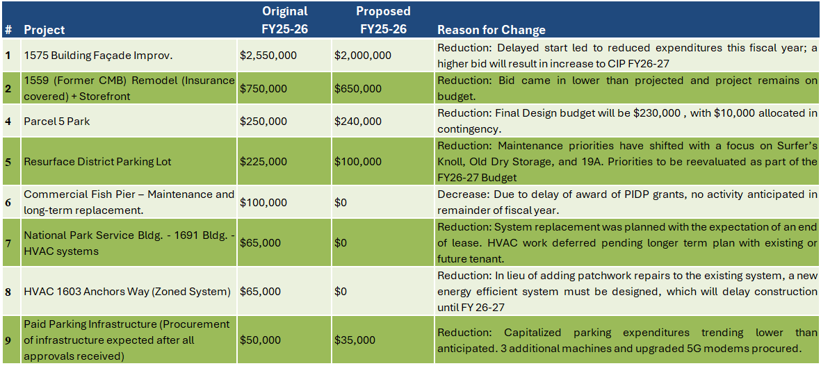
Proposed Reductions to CIP projects

Slide 32
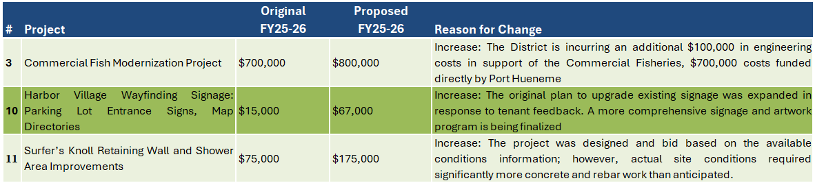
Proposed INCREASES to CIp projects

Slide 33
TENANT IMPROVEMENTS
FY25-26 Building Tenant Improvements
Staff are projecting a decrease of $110,000 in expenses from $740,000 to $630,000.
  Increase of $34,000 to District utilized building improvements
  Decrease of $135,000 to potential, foreseen, tenant turnover
  Decrease of $9,000 to unforeseen tenant turnover

Slide 34
ORGANIZATIONAL CHANGES
Administration Department
  Business Operations Manager +1.0 FTE
Harbor Patrol
  Chief of Harbor Patrol/Harbormaster
  Chief Deputy Harbormaster
  Harbor Patrol Officer III
  Total # Employees Unchanged
Marina Department
  Commercial Fisheries Manger -1.0 FTE

Slide 35
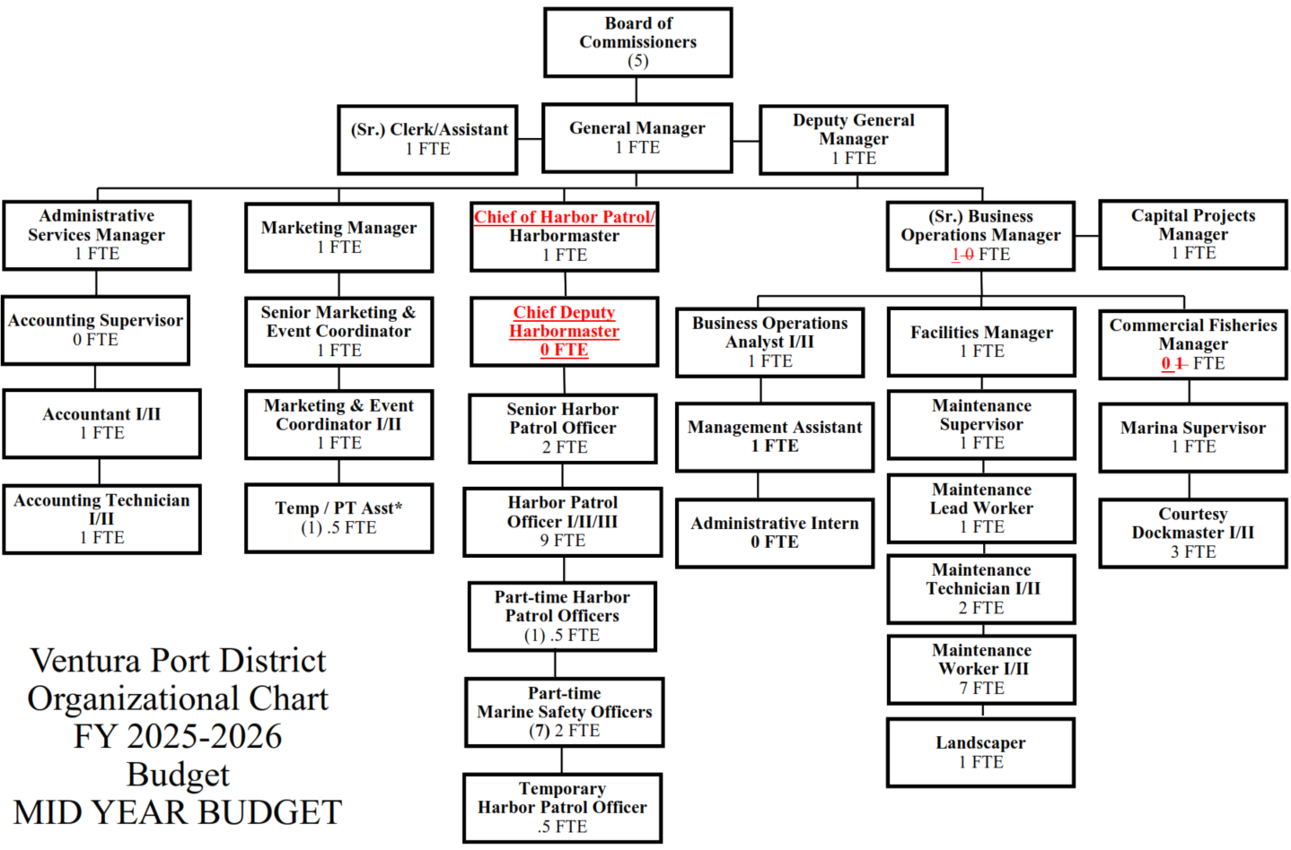
Revised Organizational Chart

Slide 36
Public Communication
STANDARD ITEM 2

Slide 37
Standard AGENDA Item
2
Adoption of Resolution No. 3550 Approving the Fiscal Year 2025-2026 Mid-Year Budget Adjustments and Capital Improvement Plan, Resolution No. 3551 Establishing the Salary Schedule for Non-Represented Employees of the District Effective January 1, 2026 and Rescind Resolution No. 3534
RECOMMENDATION:
That the Board of Port Commissioners:
a) Adopt Resolution No. 3550 approving the Mid-Year Budget Adjustments for Fiscal Year 2025-2026 effective January 1, 2026.
b) Adopt Resolution No. 3551 establishing the Salary Schedule for Non-Represented Employees of the District effective January 1, 2026.
c) Rescind Resolution No. 3534.
Report by:
Brian D. Pendleton, General Manager
Sarah Clancy, Administrative Services Manager
Justin Fleming, Capital Projects Manager

Slide 38
Standard AGENDA Item
3
Development and Implementation of a Ventura Port District Lifeguard Program for Ventura Harbor Beaches
RECOMMENDATION:
That the Board of Port Commissioners receive a report on a proposal to develop and implement a Ventura Port District ocean lifeguard program and provide direction to staff.
Report by:
John Higgins, Harbormaster
Brendan Donohue, Senior Harbor Patrol Officer
Sarah Clancy, Administrative Services Manager

Slide 39
The vision for enhanced beach safety
Current State: 15-year partnership with California State Parks is facing rising costs and staffing shortages.
The Opportunity: Develop a cost-effective, District-operated Ocean Lifeguard program starting in 2027
Core Benefits:
  Operational Control: Flexible scheduling annually including school holidays, adverse weather, and high-surf events that fall outside the traditional contract period.
  Fiscal Efficiency: Current contract exceeds $200,000 annually with 30% ($60k) diverted to Administrative & Supervisor fees rather than direct beach service.
  Professional Readiness: The Districts Harbor Patrol & Marine Safety personnel possess over 200 years of combined experience. They are already recognized as professional experts in water safety.
  “Public Safety cannot be seasonal or uncertain”

Slide 40
Fiscal Responsibility & Efficiency
Eliminate Inefficiency: Contract fees account for 26% of total costs without providing direct beach services
Cost Stabilization: Provides predictable budgeting and long-term savings by reducing exposure to contract cost increases and billing delays.
Direct Investment: Reinvesting administrative fees directly into equipment, personnel, extended seasonal coverage, & improved public safety,
Future Revenue: Potential for “Junior Lifeguard” programs to offset operating costs and support workforce development
Future Harbor Patrol Recruitment: Creates a path to full-time employment
“This is about directing Public Funds to Frontline Safety”

Slide 41
Proven Expertise & Readiness
Our Harbor Patrol & Marine Safety Officers bring over 200 years of combined experience. Much of this time is in Supervisor & Training capacities.
Staff are already trained and certified to the National United States Lifesaving Association (USLA) ocean rescue standards.
Harbor Patrol & Marine Safety Officers already perform year-round ocean rescues and are recognized as subject matter experts who train local Fire Departments.
HP & MSO staff already operate at a professional lifeguard standard in our daily operations.
“We are not starting from scratch – we are building on proven excellence”

Slide 42
Start-up Cost & Annual projections
First Year Estimated $180k
  Full seasonal Lifeguard services
  Marine Safety & Patrol Support
  Program administration & Compliance
Ongoing Annual Costs $173k
  Stabilized operational expenses
  Opportunity to extend weekend coverage and additional services
Future Cost Softening
  The creation of a Junior Lifeguard program would generate revenue & offset operating costs.
  Program would be delayed 1-2 years from start to ensure beach program success & develop workforce skills.
  “Strategy will be to hire experienced and trained local Lifeguards to lessen training costs”

Slide 43
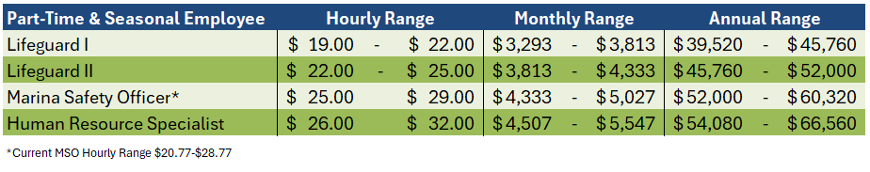
Staffing assumptions
3 lifeguard towers staffed with 1 employee each
1 lifeguard truck staffed with 1 employee
Increase in MSO pay to align ranges with laddering effect for growth
Part-time HR Specialist need for increased administration support
Salary Schedule:
“Proposal does not change current annual staffing”

Slide 44
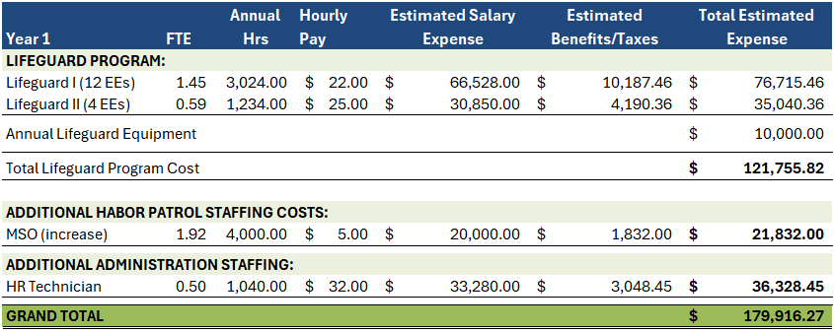
Year 1 annual costs

Slide 45
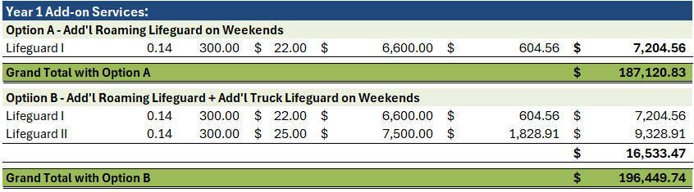
Optional add’l svcs (year 1)

Slide 46
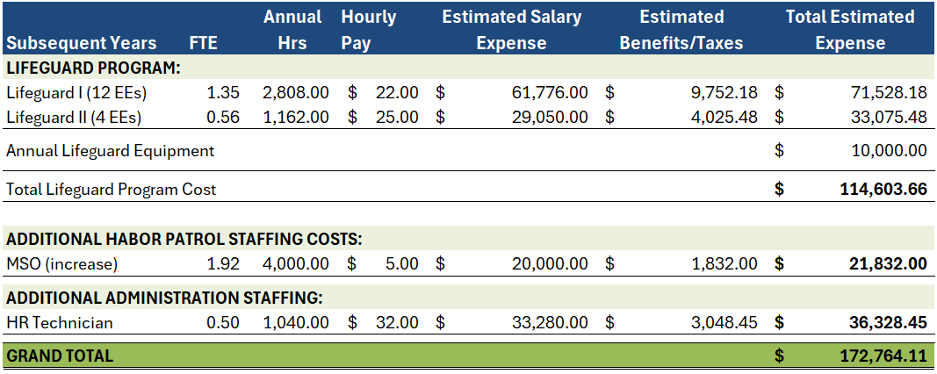
Subsequent years annual costs

Slide 47
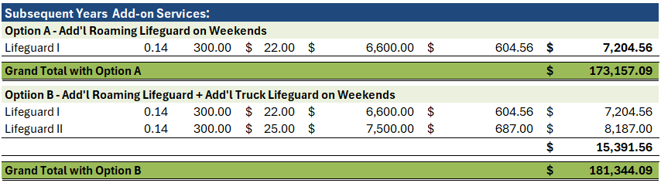
Optional add’l Svcs (subsequent Yrs)

Slide 48
Strategic Advantages & Public impact
Operational Flexibility: Ability to expand coverage during local holidays, adverse weather, or high-swell events.
Safety Record: Maintaining the high standard that has led to zero drownings during active lifeguard periods.
Enhanced Support: Includes a new HR Technician to reduce organizational risk and support sustained growth.
Local Accountability: Efficient budgeting, better oversight, and a program tailored specifically to Ventura Harbor’s unique coastline.
Supports Port District Businesses through safer beach access and programs.
“This strengthens both safety and community resilience.”

Slide 49
Public Communication
STANDARD ITEM 3

Slide 50
Standard AGENDA Item
3
Development and Implementation of a Ventura Port District Lifeguard Program for Ventura Harbor Beaches
RECOMMENDATION:
That the Board of Port Commissioners receive a report on a proposal to develop and implement a Ventura Port District ocean lifeguard program and provide direction to staff.
Report by:
John Higgins, Harbormaster
Brendan Donohue, Senior Harbor Patrol Officer
Sarah Clancy, Administrative Services Manager

Slide 51
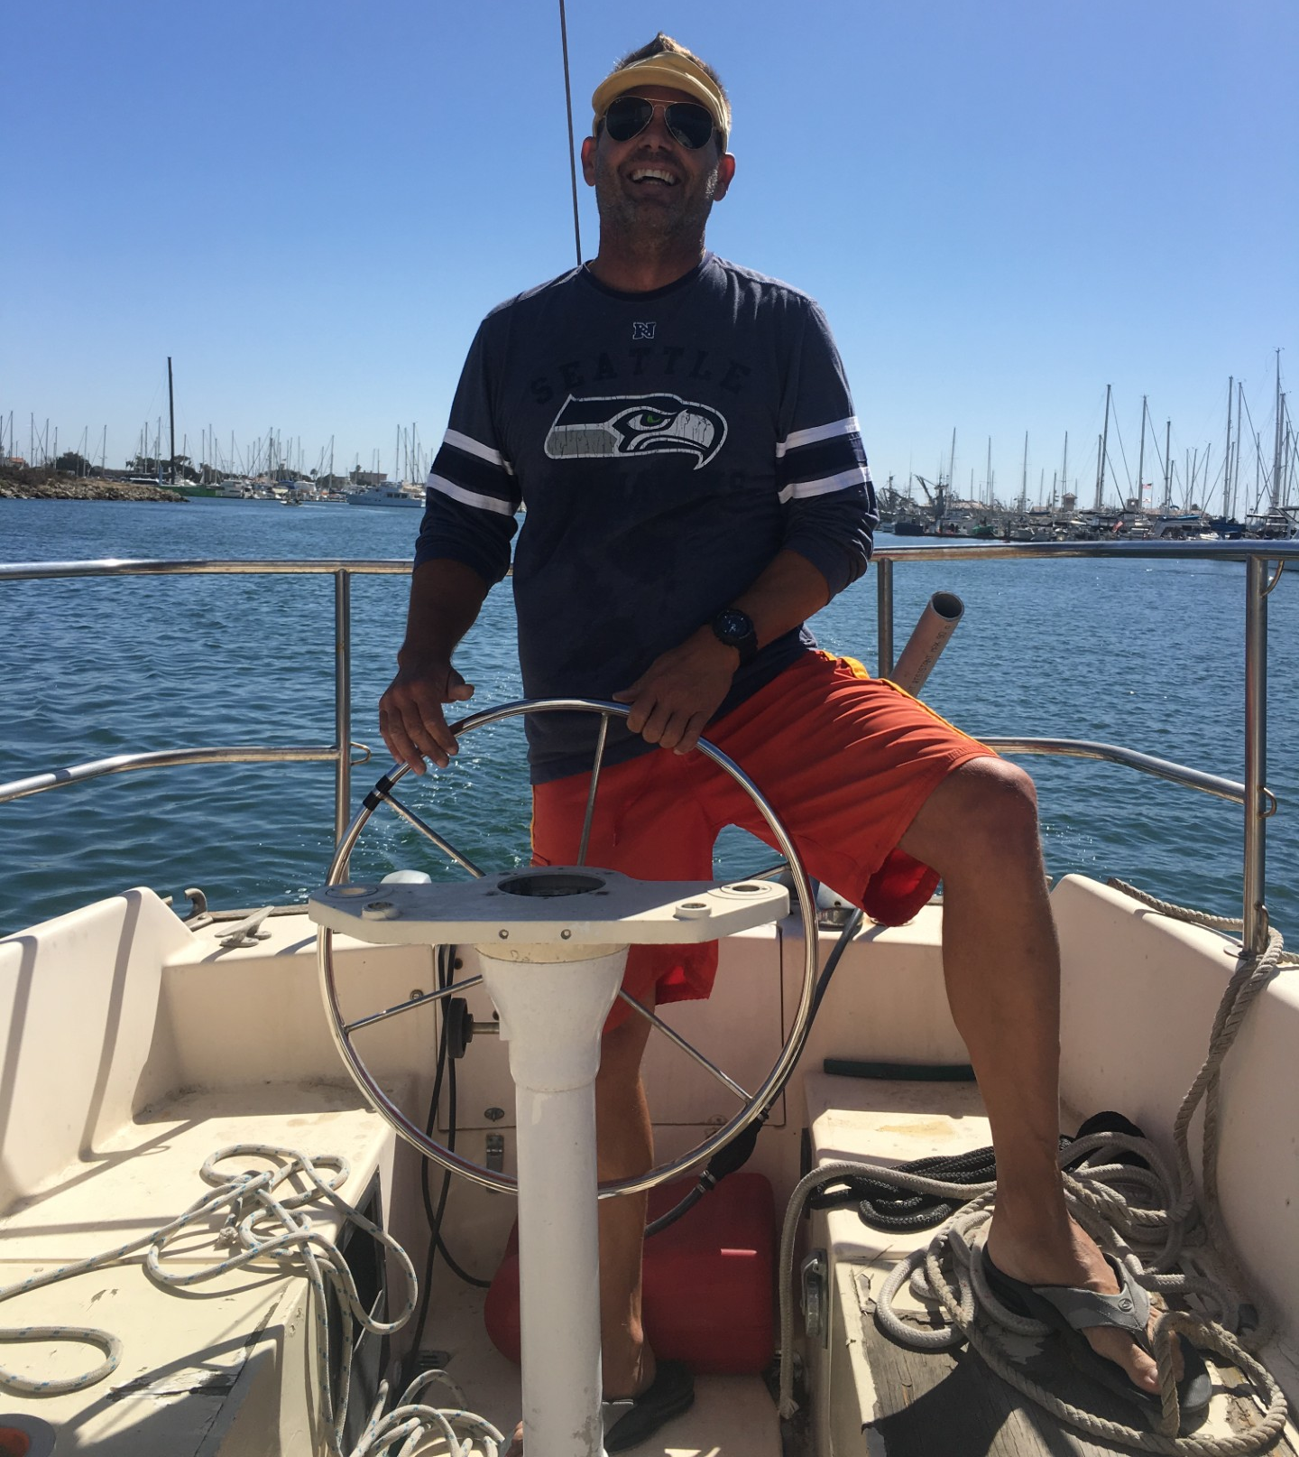
Adjournment IN LOVING MEMORY OF
ERIK BEAR, HARBOR Patrol OFFICER
Next Meeting MARCH 4, 2026

